Slide 1
Music Ed Matters Campaign

Slide 2
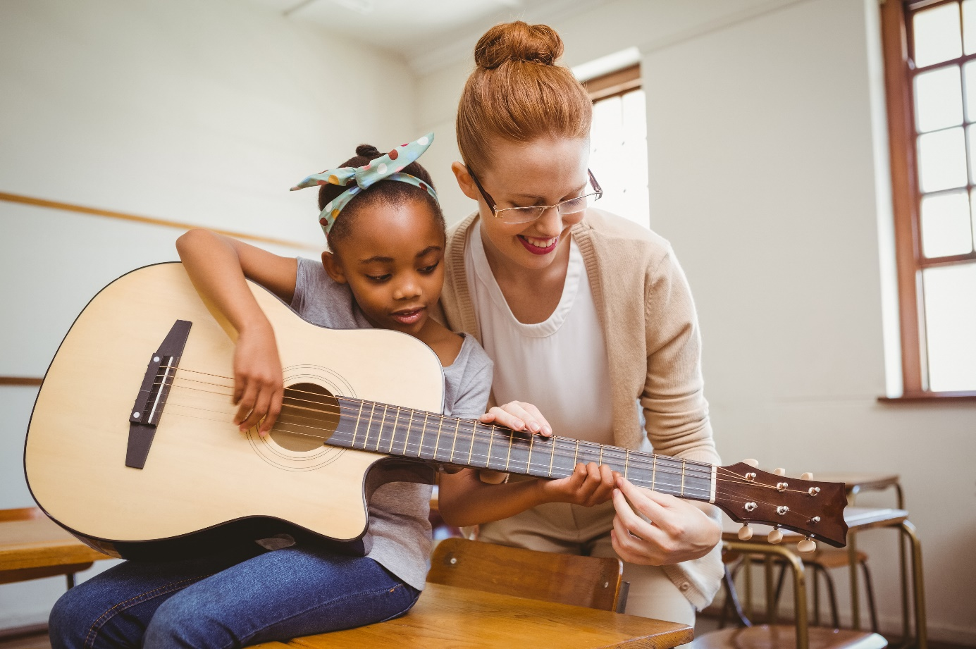
Give a Note Foundation
Give a Note was created in 2011 by the leaders of the National Association for Music Education (NAfME). Their mission is to nurture, grow, and strengthen music education opportunities for every student, every school, and every community.

Slide 3
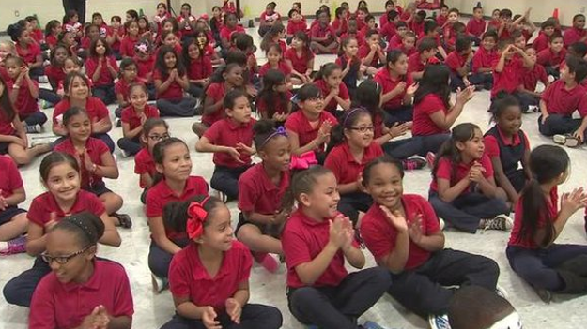
Give a Note Foundation
The foundation was established to ensure that all children have access to the life-changing benefits of music study.
Music helps students develop important skills tied to life-long success – collaboration, creativity, critical thinking, and communication.

Slide 4
The Problem
Many underserved schools around the country do not receive the support they need to sustain their music programs. Many are cut from the budget.
Give a Note shines a spotlight on areas of need, the value of music education in the lives of all students, and the great work of the music teachers who reach those students.

Slide 5
A Solution
Give a Note is inviting music education supporters to join the #MusicEdMatters initiative by becoming a fundraiser! The money raised from this campaign will go towards Give a Note Foundation programs and grants to schools in underserved communities across the country.

Slide 6
The Ask
We are recruiting passionate individuals to raise funds on behalf of Give a Note Foundation to reach our goal of $50,000 by the new year! The campaign will kick-off October 1st and will run until December 31st.
We invite our participants to leverage their networks and talents to help us further the Give a Note mission.
Participants will be able to create their own fundraising page and will be provided with campaign strategy recommendations.

Slide 7
Reach Your Goal: A Recommended Strategy
Ask your community! Invite local businesses to support the cause! Below is a great idea to involve wineries and breweries in your area. Modify to fit your neighborhood.
November is National Philanthropy Month. Invite wineries and breweries to run a drink special every Saturday and Sunday during the month of November while local musicians play at their venue. We suggest a special of $5. All first drink proceeds will go to the campaign. All drink revenue following will go to the venue.
Let’s say 100 people visit a winery/brewery each day. If only 50% purchase the drink special, you will still be able to bring in $500 per weekend per venue.

Slide 8
Get Started
Create your fundraising page today! Bit.ly/MusicEdGNF
All resources and tools can be found at Bit.ly/MusicEdMatters.

Slide 9
Questions
Please direct all questions to musicinspires@giveanote.org.

